Slide 1
NYC Airbnb
Price Analysis
Presented by
Donghua Xiong,
Tiffany Chang,
Yilun Ma,
Yanfu Wang

Slide 2
What We Have Done
in the Midterm Presentation
We’ve
filled missing data
dropped duplicated data
removed the following columns:
name
host_name
last_review
id
host_id
reviews_per_month
number_of_reviews

Slide 3
Problem Statement
Goal
Build a Machine Learning Model to Predict Airbnb Price
Price
Feature Selection Hypothesis
neighbourhood_group
neighbourhood
room_type
minimum_nights
reviews_per_month
availability_365
longitude

Slide 4
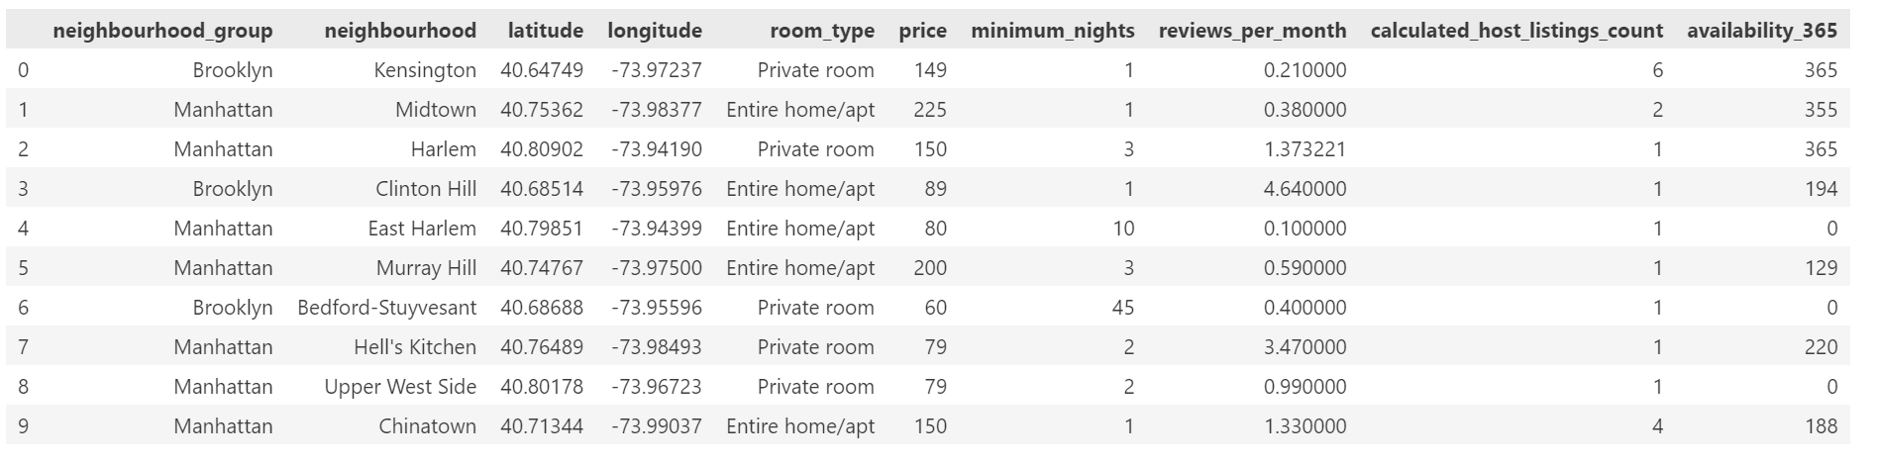
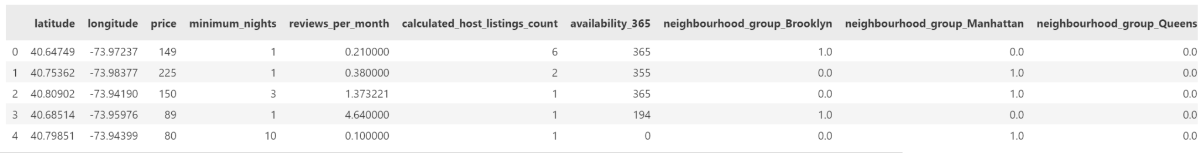
Feature Engineering
OneHotEncoder

Slide 5
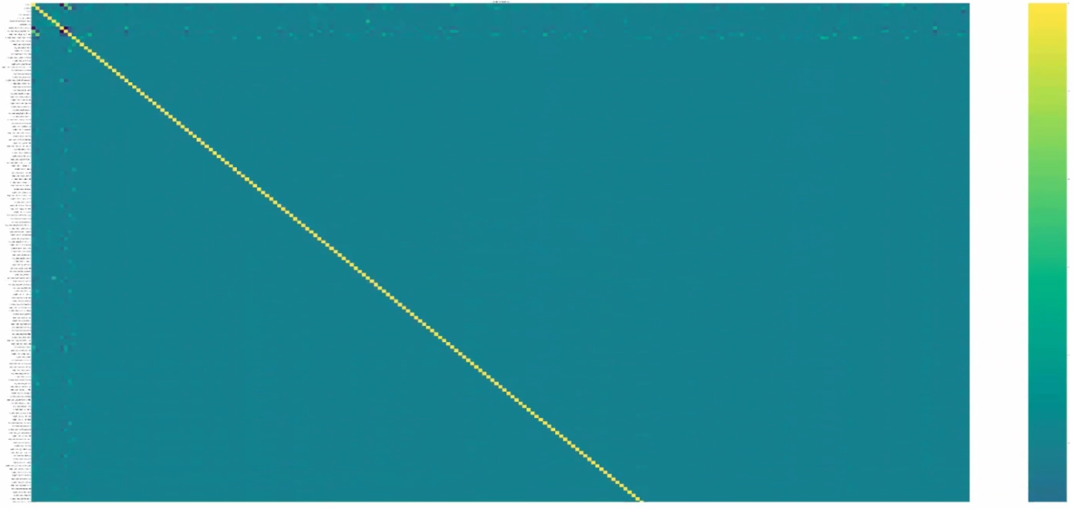
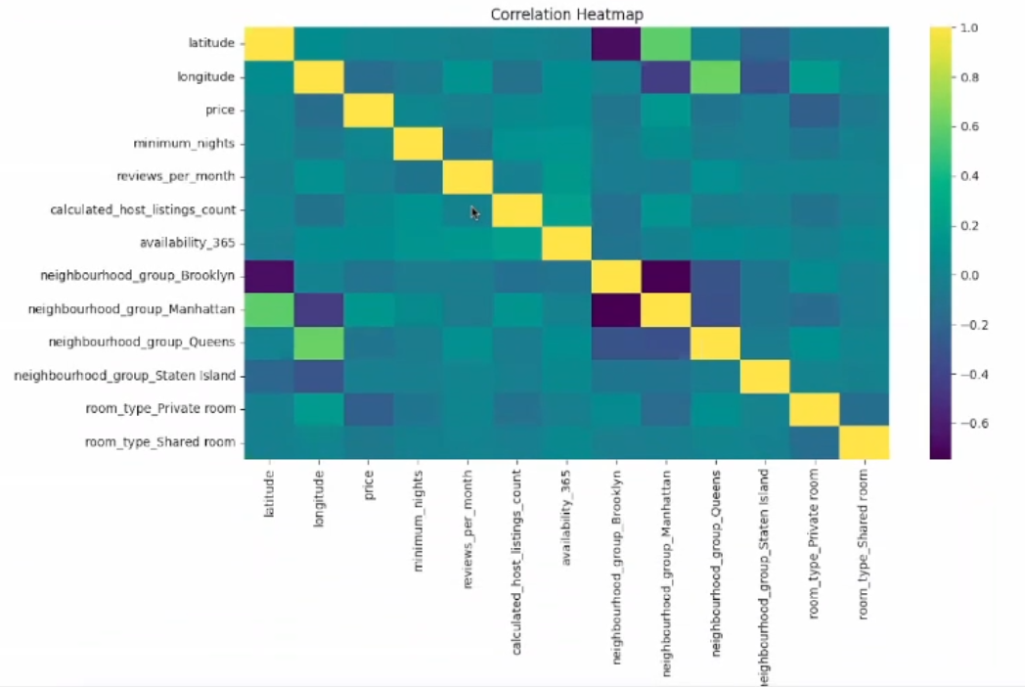
Correlation Heat Map
→

Slide 6
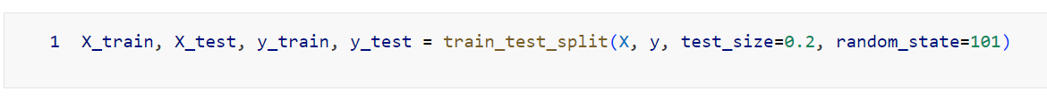
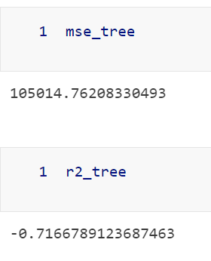
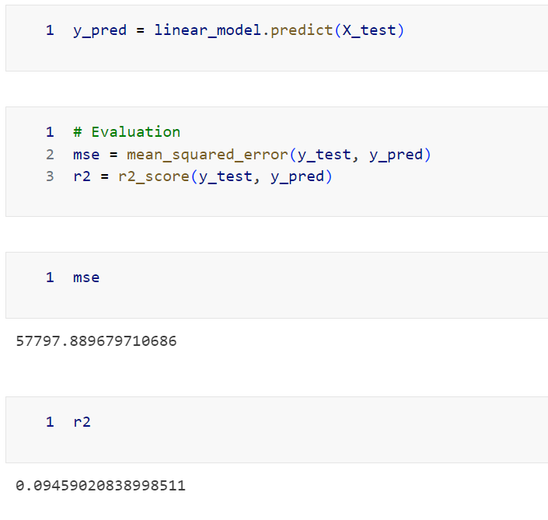
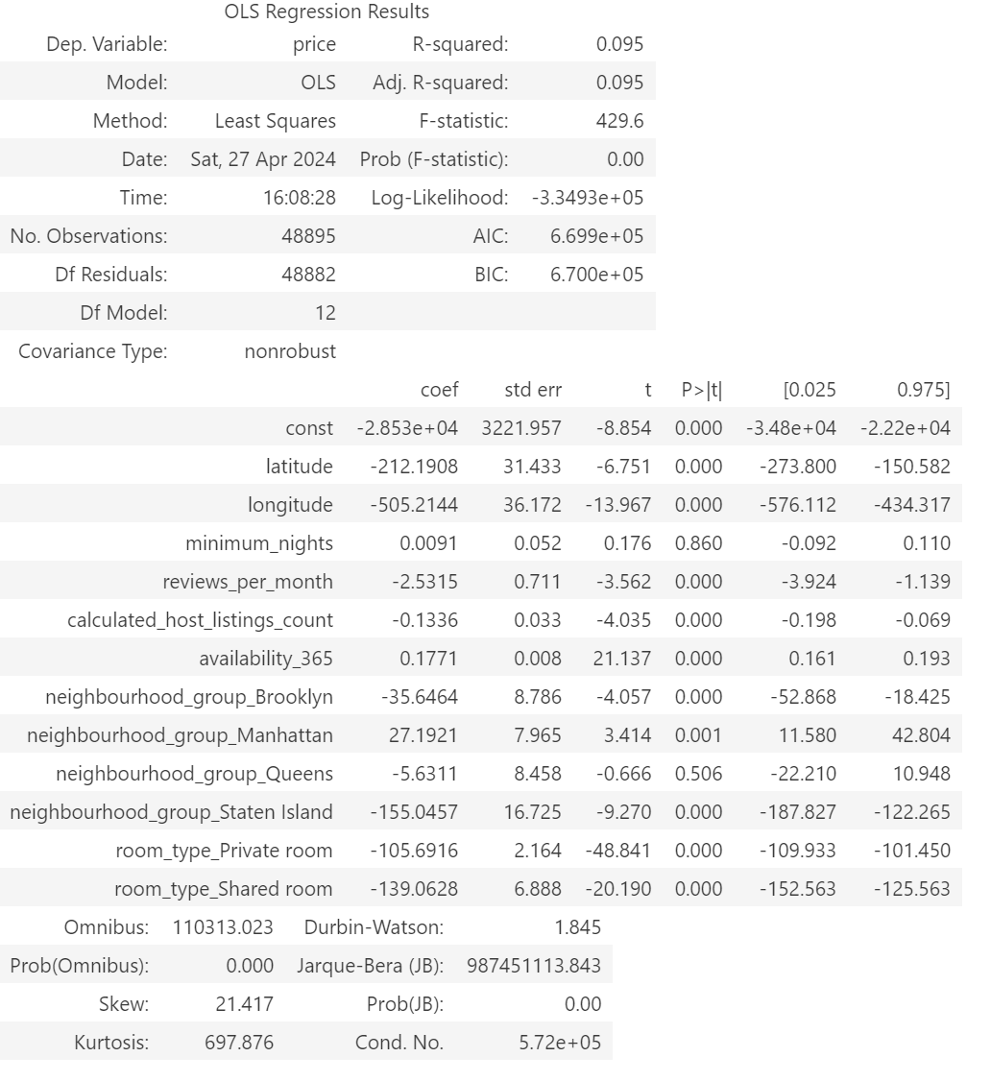
Linear Regression
Decision Tree

Slide 7
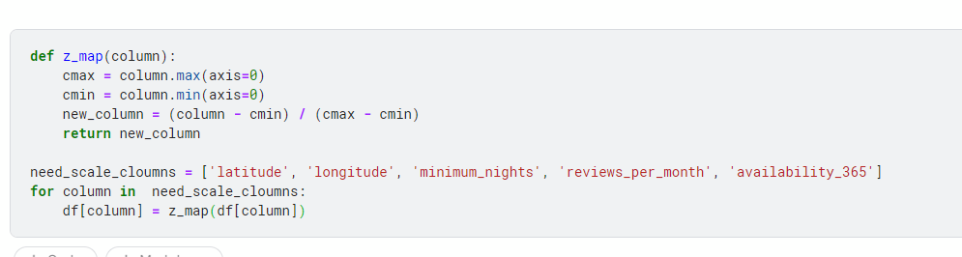
Feature Engineering: Continuous Data
Normalization for continuous data:

Slide 8
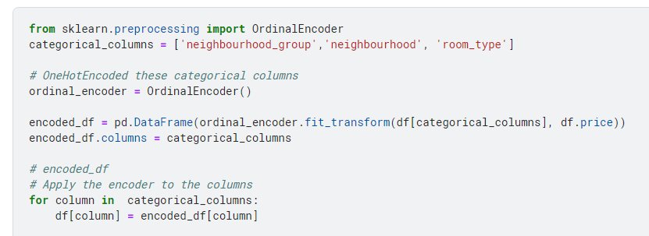
Feature Engineering: Discrete Data
Ordinal Encoding relative to price

Slide 9
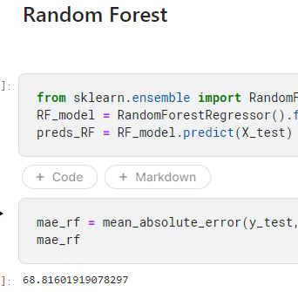
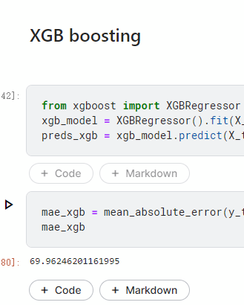
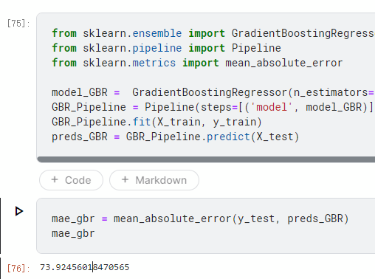
Result:

Slide 10
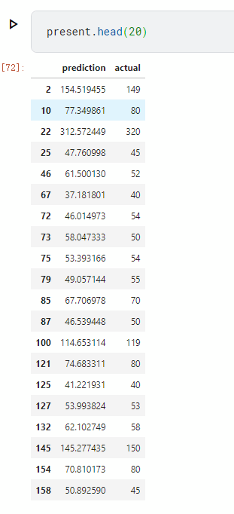

Slide 11
Overview of Logistic Regression Models
Model segmentation based on price percentiles: we segmented our approach into three distinct logistic regression models. Each model is based on significant price thresholds identified through a statistical analysis of our dataset, specifically the 25th, 50th, and 75th percentiles.
they represent critical segments of the Airbnb market in NYC, which are $69, $106, and $175 respectively.
Impact of percentile-based models on pricing analysis: By these models, we can have an overall understanding of the pricing strategy at NYC

Slide 12
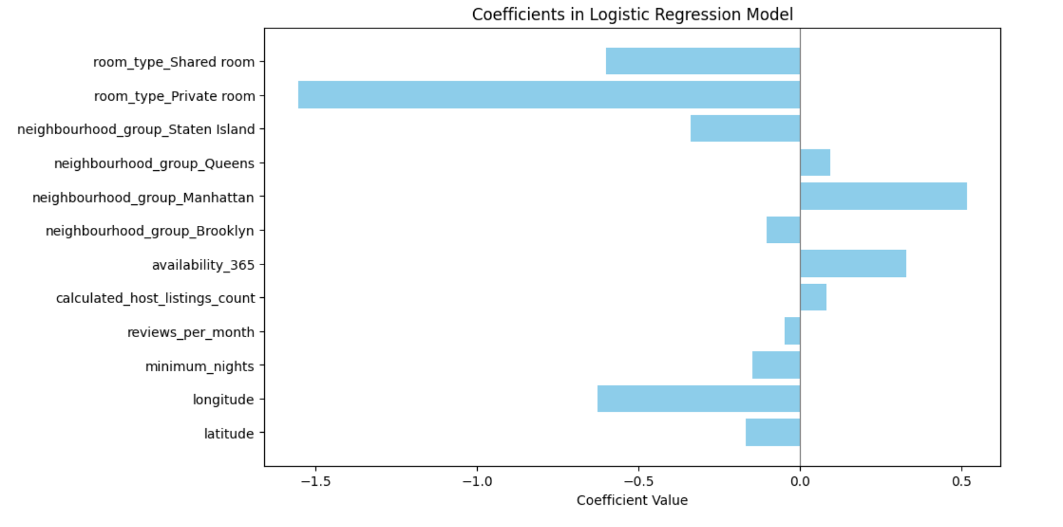
Process and Results for Model 1 (Price > or < $106)
We use Onehot encoder to turn categorical variables into numbers
We clean the dataset and give every data a categorical label
We label all house price below the median as 0
All houses with price above median as 1
We use a logistic regression model to simulate the distribution and try to predict the coefficient of each variable

Slide 13
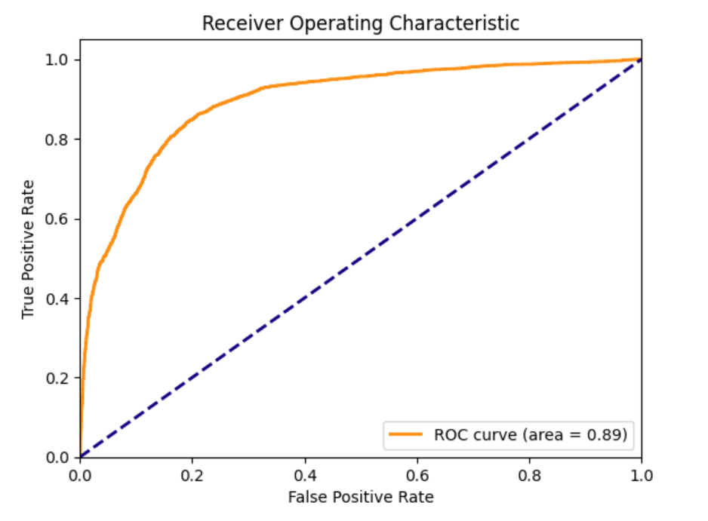
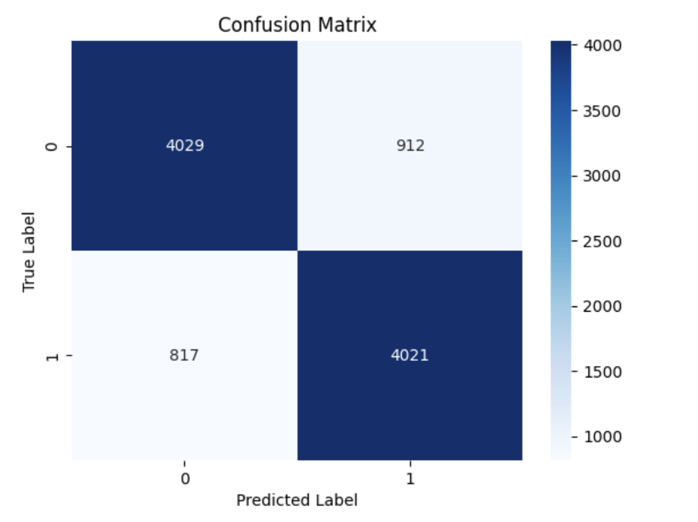
Analysis for Model 1 (Price > or < $106)

Slide 14
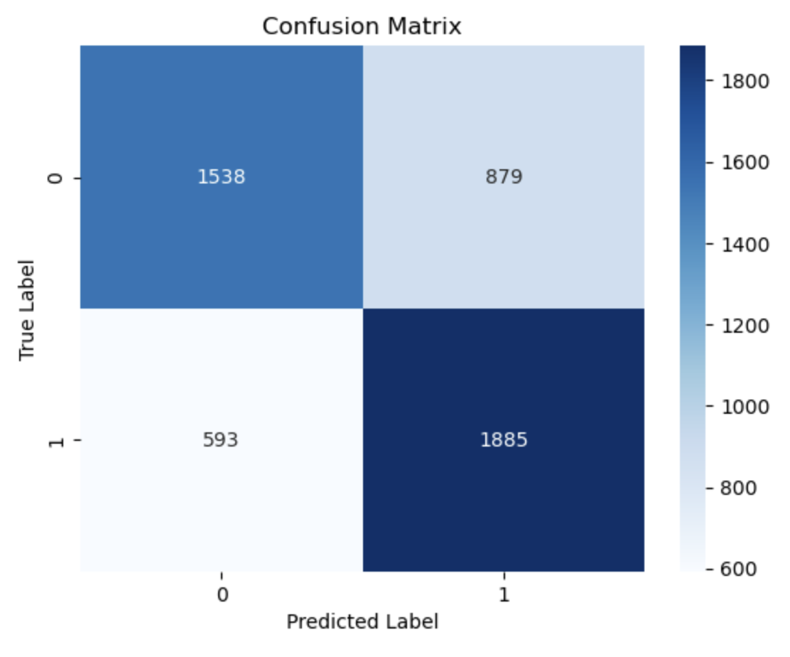
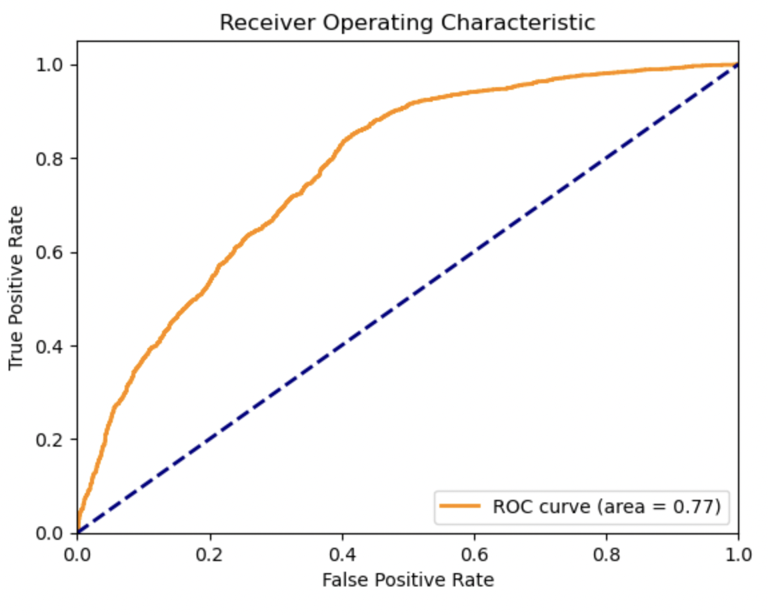
Results for Model Listings below $106
Effective prediction for lower-end listings: Model's efficiency in predicting below $106 listings aids in strategic pricing decisions.
Importance of 25th percentile relation at $69: Relating model performance to the 25th percentile enhances understanding of lower-priced market segments.

Slide 15
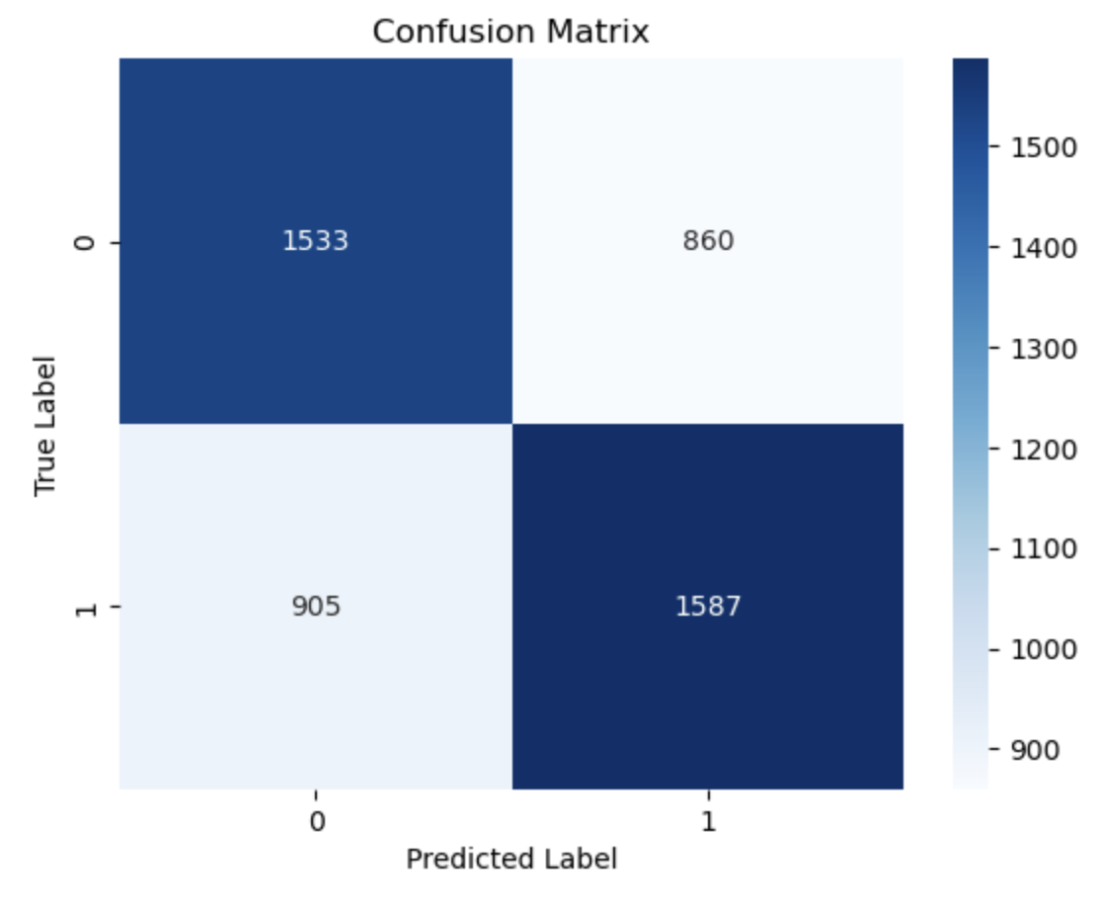
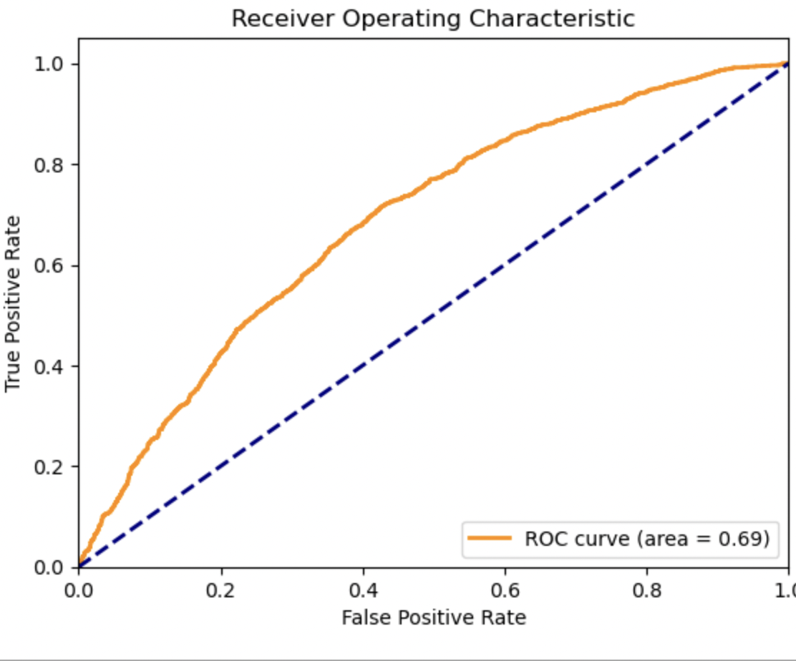
Results for Model Listings above $106
Model evaluation on listings above $106: Examining model performance on high-priced listings reveals insights for luxury market.
Comparison to 75th percentile at $175: Relating model performance to the 75th percentile highlights predictive power for premium listings.

Slide 16
Thank you

